Slide 1
MLA Format & Works Cited Page

Slide 2
An MLA Style Paper Should:
Double-space everything
Use 12 pt. Times New Roman
Number each page in the upper right hand corner (Last Name Page #)
Indent the first line of each new paragraph
Center the paper title (use standard caps but no underlining, italics, quote marks or bold face)
Header – Name, Teacher’s Name, Class, Date (Upper Left Hand Corner)

Slide 3
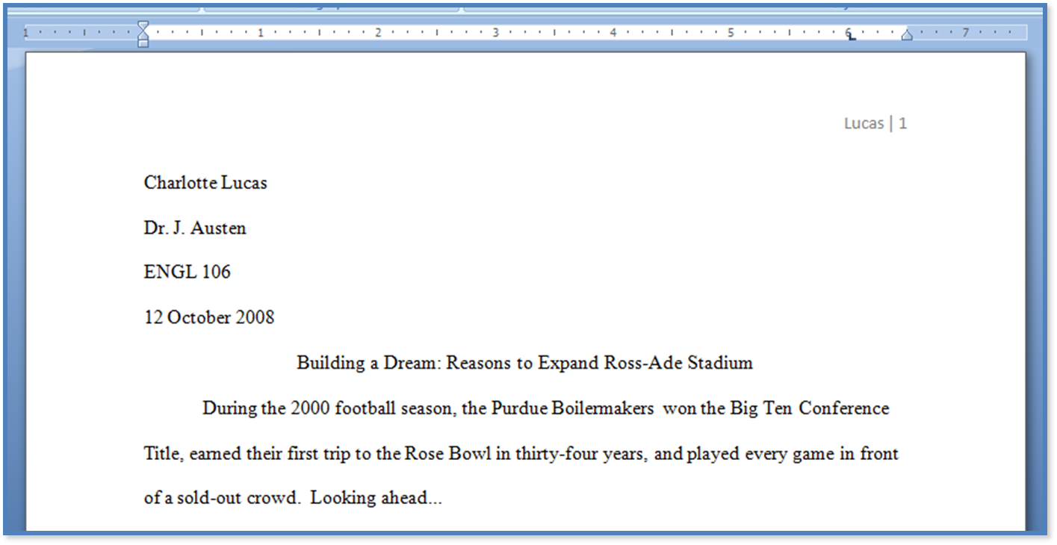

Slide 4
Works Cited Page:
Any time you use outside sources to help you write a paper, you need to create a works cited page to give credit to the author
Always begin Works Cited on a new page
Title the page Works Cited (do not italicize, bold, underline or put in quotation marks)
Citations go in alphabetical order
Double-space all citations, but do not skip extra spaces between entries
DO NOT indent the first line of citations, BUT indent the second line (and any additional lines that follow for a single citation)

Slide 5
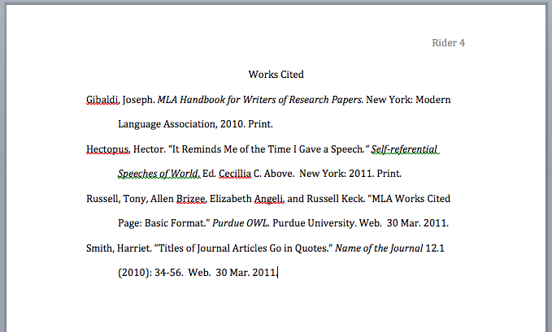

Slide 6
MLA Citations
Last, First. “Title of Article.” Publisher, Date Published. Web.
Date Accessed.
Williams, Amy. “Risk Factors and Why Teens Use.” Partnership for
Drug Free Kids, 7 April 2013. Web. 5 November 2018.
In Text Citation Example:
When Author is Provided - (Williams).
When Author is Not Provided – (“Risk Factors and Why Teens Use”).

